Slide 1

EDA on GLOBAL TERRORISM DATA
INDIVIDUALLY DONE BY PARSHVA R KARANI
(Under the guidance of Team ALMABETTER)

Slide 2
Data reading
Data Preparing
Data Cleaning
Exploring Data Analysis
Data Visualization
Conclusion
DATA PIPELINE

Slide 3
Data Pipeline :
A data pipeline is a set of tools and processes used to automate the movement and transformation of data between a source system and a target repository.
Data Reading :
read and write tabular data using pandas functions.
Data preparation :
Data, when initially obtained, must be processed or organized for analysis. For instance, these may involve placing data into rows and columns in a table format (known as structured data) for further analysis, often through the use of spreadsheet or statistical software.
Cleaning the Data :
Data cleaning is the process of fixing or removing incorrect, corrupted, incorrectly formatted, duplicate, or incomplete data within a dataset.
Exploratory data analysis :
Once the datasets are cleaned, they can then be analyzed. Analysts may apply a variety of techniques, referred to as exploratory data analysis, to begin understanding the messages contained within the obtained data.
Data visualization :
Data visualization is the graphical representation of information and data. By using visual elements like charts, graphs, and maps, data visualization tools provide an accessible way to see and understand trends, outliers, and patterns in data.

Slide 4
Problem Statement
Identify hotspots of terrorist activity.
Analyze trends over time.
Evaluate the impact of counter-terrorism measures.
Study the characteristics of terrorist organizations.
Assess the economic costs of terrorism.
Understand the motivations of terrorists.
Evaluate the effectiveness of different tactics.
Identify emerging threats.
Develop predictive models.
Inform policy decisions.
Understand the impact of terrorism on society.
Compare trends across countries.
Evaluate the effectiveness of international cooperation.
Inform public discourse.
Enhance public safety.

Slide 5
Technologies and Libraries Used
Python
NumPy
Pandas
Matplotlib
Seaborn
: the programming language
: for computational Operations
: for Data manipulation and aggregation
: for plotting charts and visualizations
: for high API visualizations
Google Collab : for writing and performing Coding and EDA
Reference :
https://www.w3schools.com/
https://stackoverflow.com/
https://www.almabetter.com/courses/full-stack-data-science

Slide 6
Description of individual Variable
date- date of attack
Eventid - unique event id for all attack
extended- whether attacks were extended for more then 24hrs or not, 1 if extended.
resolution - Did attacker came to resolve attack and end attack, 1 if yes.
country - country in which attack happened by code
Country_txt - Name of country
Region - region in which attack took place, 1-12.
city- particular city in which attack happened.
crit1 - Does intentions of attack fits in criteria 1, 1 if yes
crit2- Does intentions of attack fits in criteria 2, 1 if yes
crit3- Does intentions of attack fits in criteria 3, 1 if yes
Doubtterr - when we dont know actual intention of attack
success - whether attack was successfull or not
Suicide - wheather attacker died in attack.
attacktype1 - Type of attack.

Slide 7
attacktype1_txt- text of of attacktype.
targtype1 - Target audience of attack
Name of group who conducted attack
claimed- whether attack was claimed or not.
claimmode - By which platform attack was claimed
weaptype1 - Type of weapon used to conduct attack
nkill - Number of kills happened in attack.
nwound- number of people wounded by attack
property- whether property damage was involved or not
propextent- type of property involved in damage
propvalue - approx value of property damage
ishostkid - whether people were taken hostage or not
Divert - did attacker did something to divert attention from attack
Ransom - did attacker asked for ransom or not
hostkidoutcome- what was outcome if hostages were taken

Slide 8
About Dataset
The Global Terrorism Database (GTD) is a comprehensive and reliable source of information about terrorist incidents that have occurred worldwide since 1970. It contains detailed information on over 200,000 terrorist attacks, including the date, location, weapons used, number of casualties, and the groups or individuals responsible for the attacks.
The database is maintained by the National Consortium for the Study of Terrorism and Responses to Terrorism (START), which is based at the University of Maryland. The GTD is constantly updated with new information on terrorist incidents from around the world and is widely recognized as one of the most authoritative sources of data on terrorism worldwide.
The GTD is organized into rows and columns, with each row representing a single terrorist event and each column providing specific details about the event. Some of the key columns in the database include the type of attack, the target of the attack, and the number of casualties. The database provides information on the economic costs of terrorism, such as the impact on tourism, trade, and foreign investment.
Researchers and policymakers use the GTD to analyze trends in terrorist activity, understand the motivations and characteristics of terrorist groups, evaluate the effectiveness of counter-terrorism measures, and inform policy decisions on issues such as border security and military strategy. The database is also used by journalists and the media to report on terrorism incidents around the world.

Slide 9
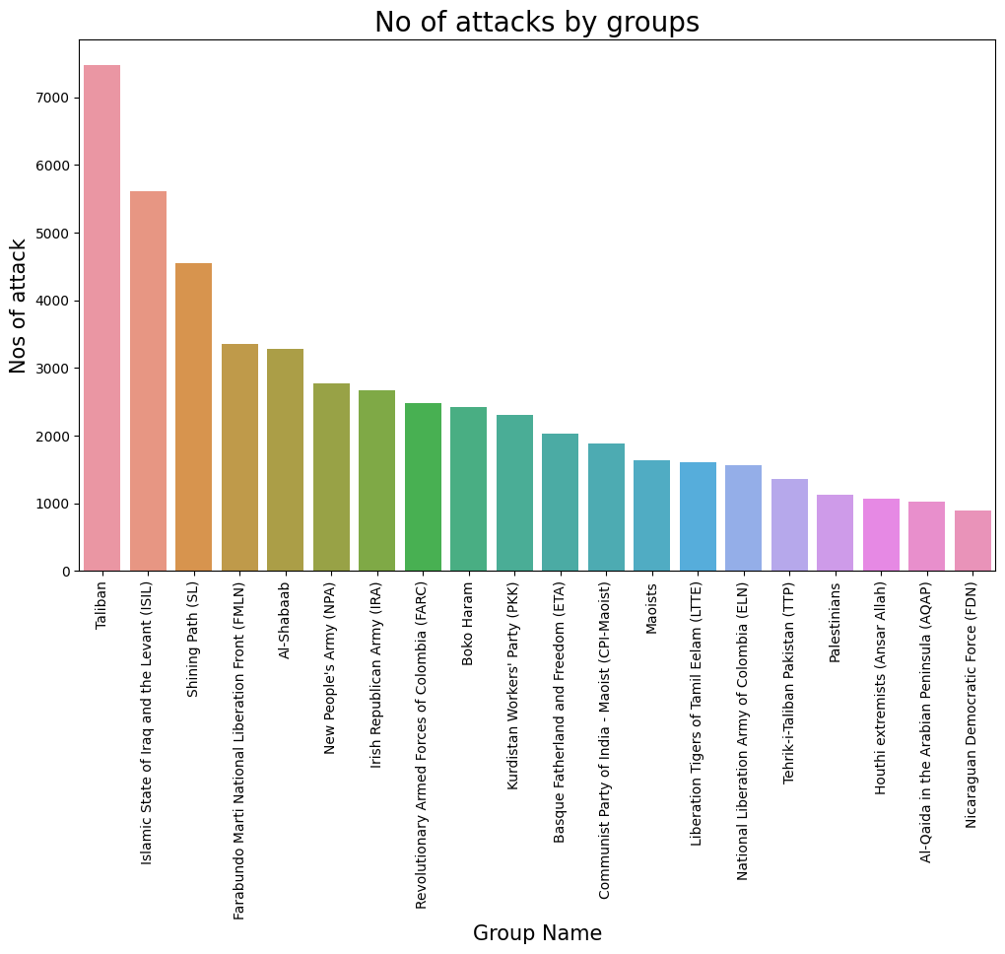
As we can see here x-axis represents group name while y-axis represent number of attacks by them.
Taliban had most number of attack which is more then 7000 followed up by Islamic state of Iraq and the levant which has more then 5000 attacks.
By seeing this data we can know which group had most number of attack and where anti-terrorist group should by deployed.

Slide 10
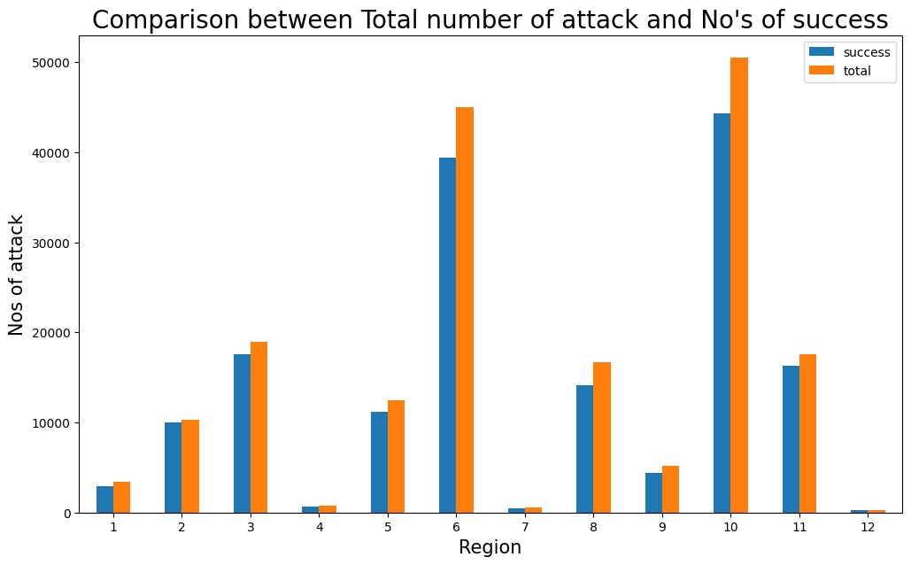
This particular chart represents total number of attack and numbers of attack that are successful in particular region.
Here we can clearly see Region 10 and region 6 had most number of attack as well as success.
While region 4 had least number of attack.
Region 10 represents Southeast Asia, Region 6 represents centre Asia, while region 4 represents Western Europe.

Slide 11
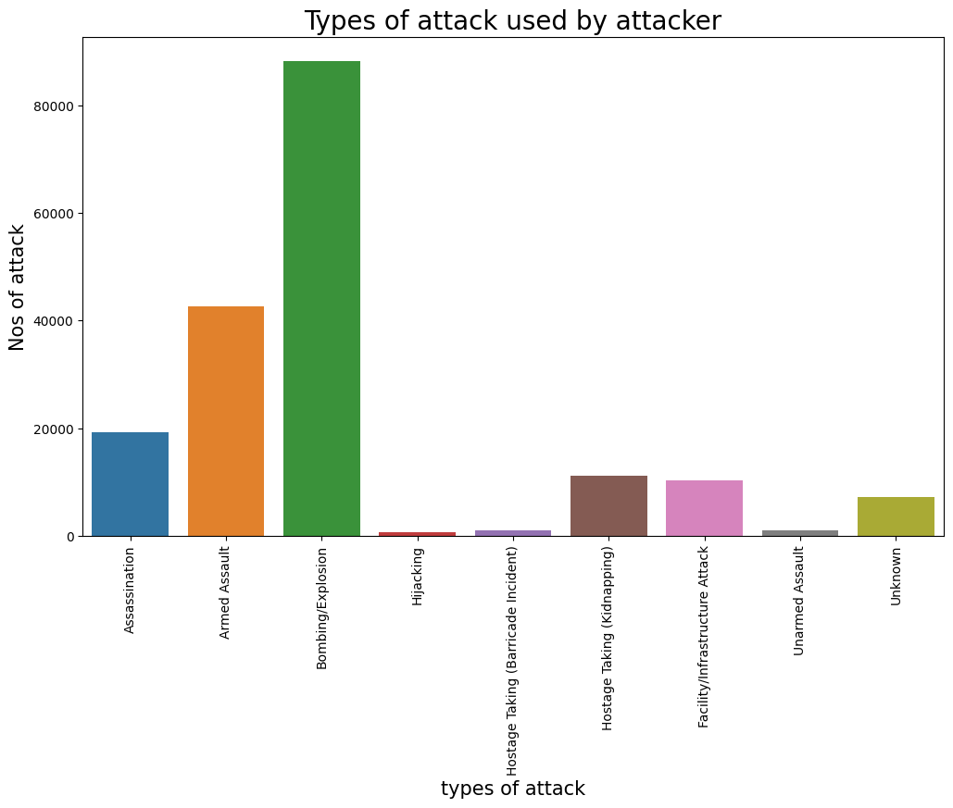
This chart represents numbers of attack done by different types of attack.
Here we can clearly see Bombing/Explosion had most number of attack more then 80 thousands while hijacking had least number of attack.
By using this data we can know that where anti-Terrorist had to prepare themselves most.

Slide 12
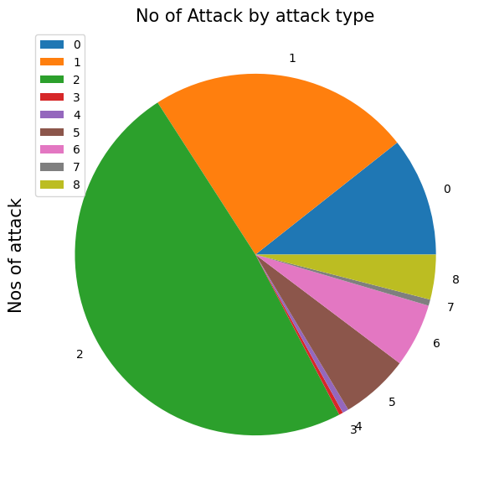
0 | Assassination | 19312
1 | Armed Assault | 42669
2 | Bombing/Explosion | 88255
3 | Hijacking | 659
4 | Hostage Taking (Barricade Incident) | 991
5 | Hostage Taking (Kidnapping) | 11158
6 | Facility/Infrastructure Attack | 10356
7 | Unarmed Assault | 1015
8 | Unknown | 7276

Slide 13
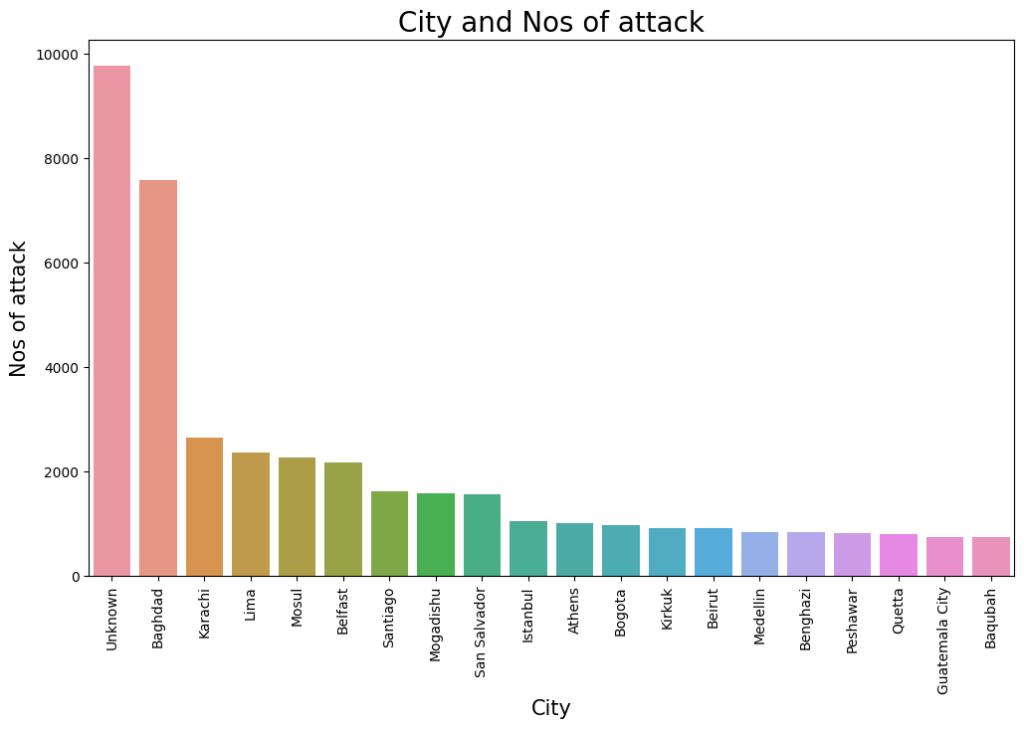
This chart represents Number of attack in each city.
Here we can can we have lots of unknown city name , maybe because of unknown data location, but after that we can see Baghdad had most number of attack more then 7 thousand, following up by karachi and lima.
This data can be useful to see where more Anti-terrorism should be deployed and more precautions should be taken.

Slide 14
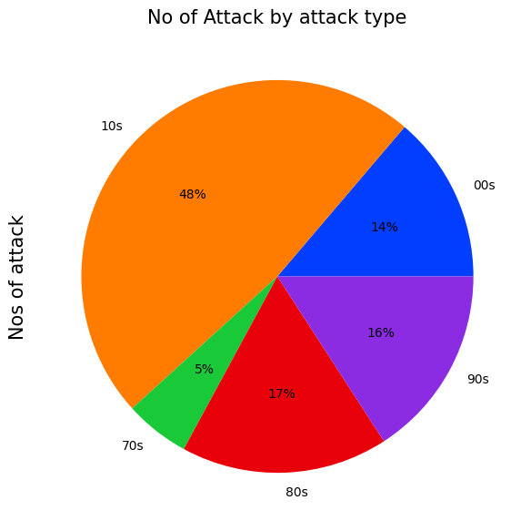
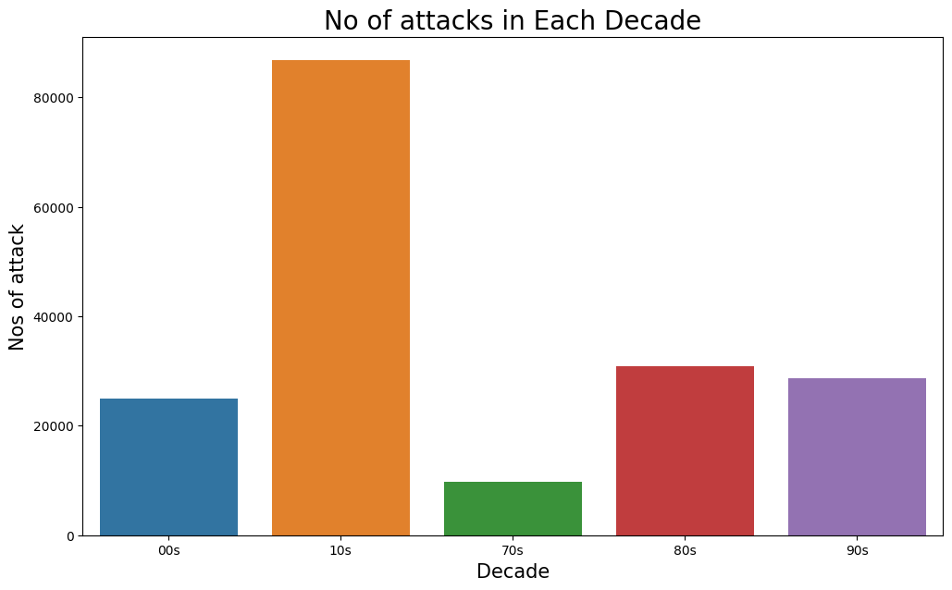
Here we can see bar chart and pie chart representing attacks on each decade.
Here data clearly tells us that decade 10s had most number of attack more then 8000, almost 48%. While decade 70s had least number of attack.
*Some data can be false or not collected.

Slide 15
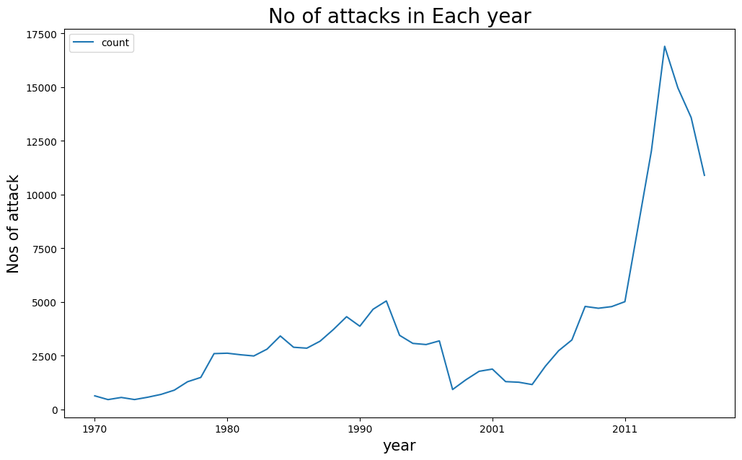
This line graph tells us a lot about attack in each year.
Clearly there has been huge increase in number of attack after 2005.
Such incident tells us that recently there has been less measure taken against terrorism and terrorist activity has been increased rapidly.

Slide 16
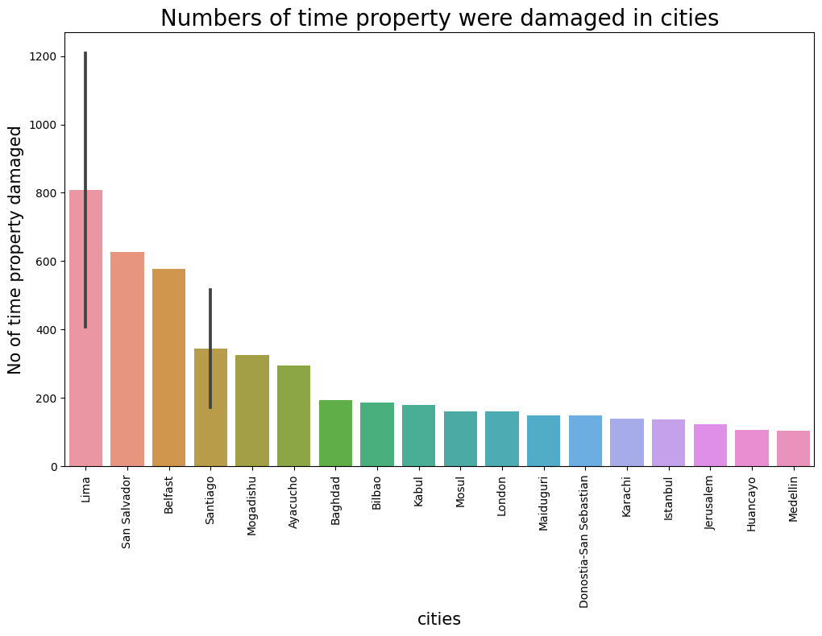
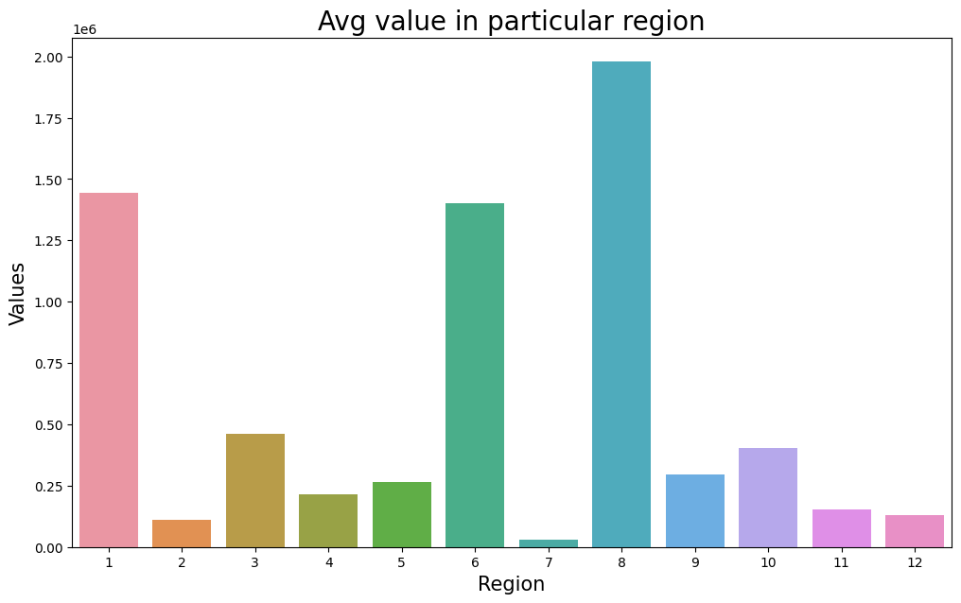
This bar graph shows number of time properties were damaged in each city.
Here we can clearly see Lima city has most number of damage, following up by San-Salvador.
Proper measure should be taken to avoid further damage in these city.
This chart shows how much average damaged has happened in each region whenever terrorist attacks has taken place.
We can clearly see region 8 had most Avg damaged.

Slide 17
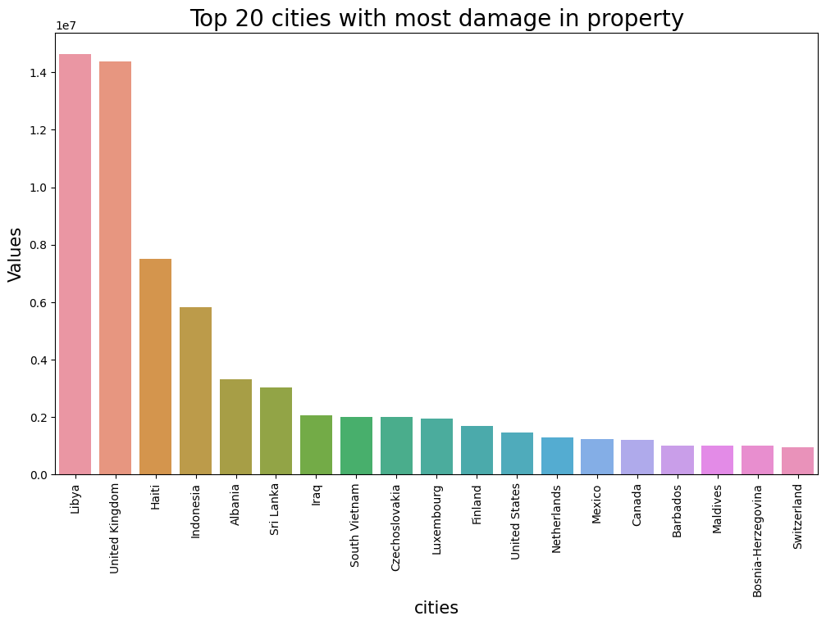
This chart here show how much total damaged has happened in each city.
Here Libya and United kingdom had most value of property damage which is around 1 lakh 40 thousand dollars, following up by Haiti which has 75 thousand worth of damage.
Such incident are signs that terrorist had proper intentions of damaging property or we can say goal were to damage property.

Slide 18
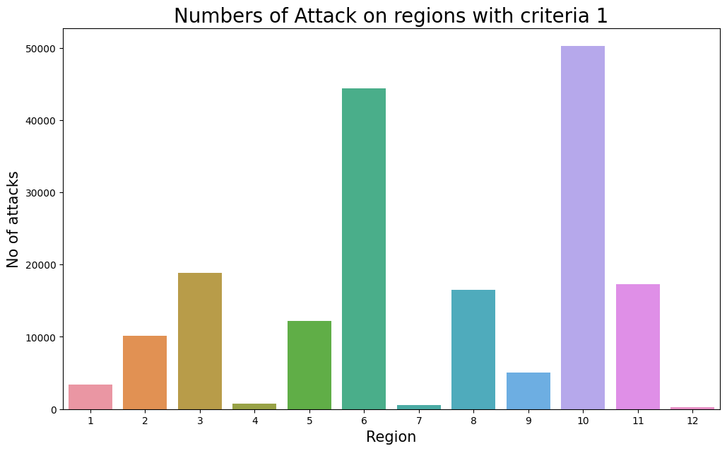
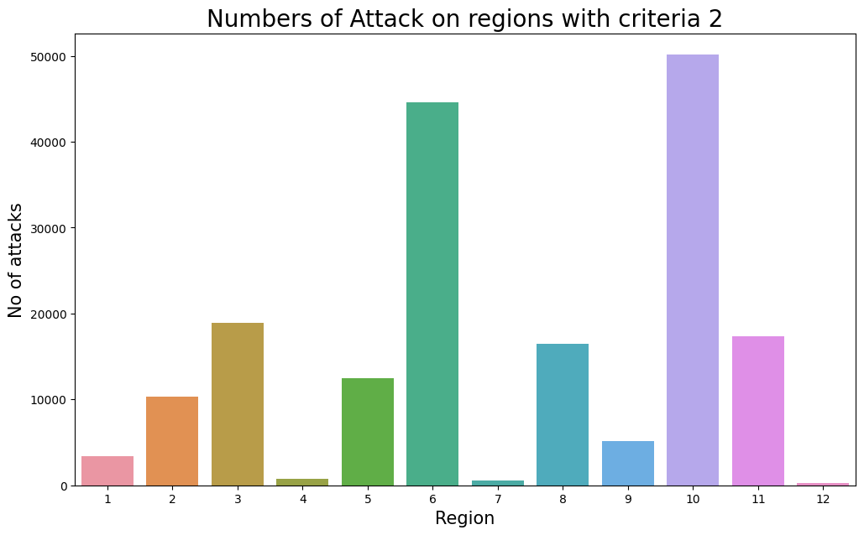
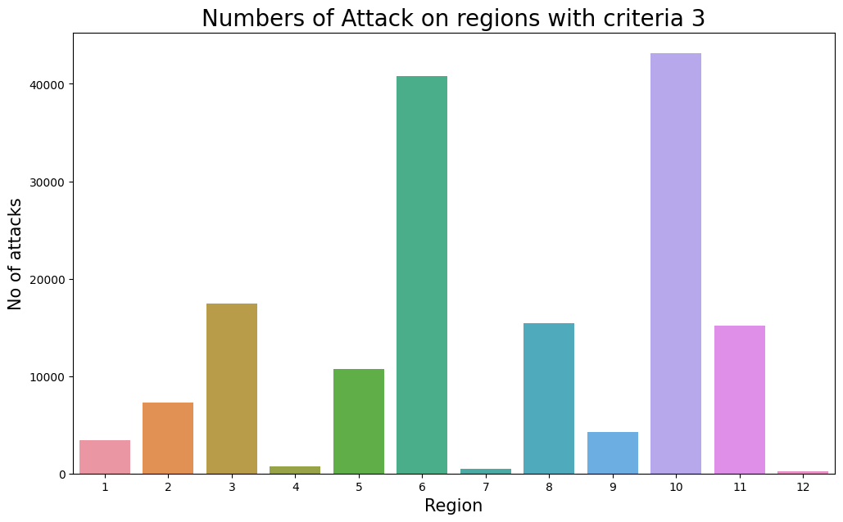
Here are 3 charts which represent numbers of attack in each region based on their criteria for attack.
The act must be aimed at attaining a political, economic, religious, or social goal.
The act must be intended to coerce, intimidate, or convey some other message to a larger audience (beyond the immediate victims).
The act must be outside the context of legitimate warfare activities.
These are the 3 criteria in which charts are based on.

Slide 19
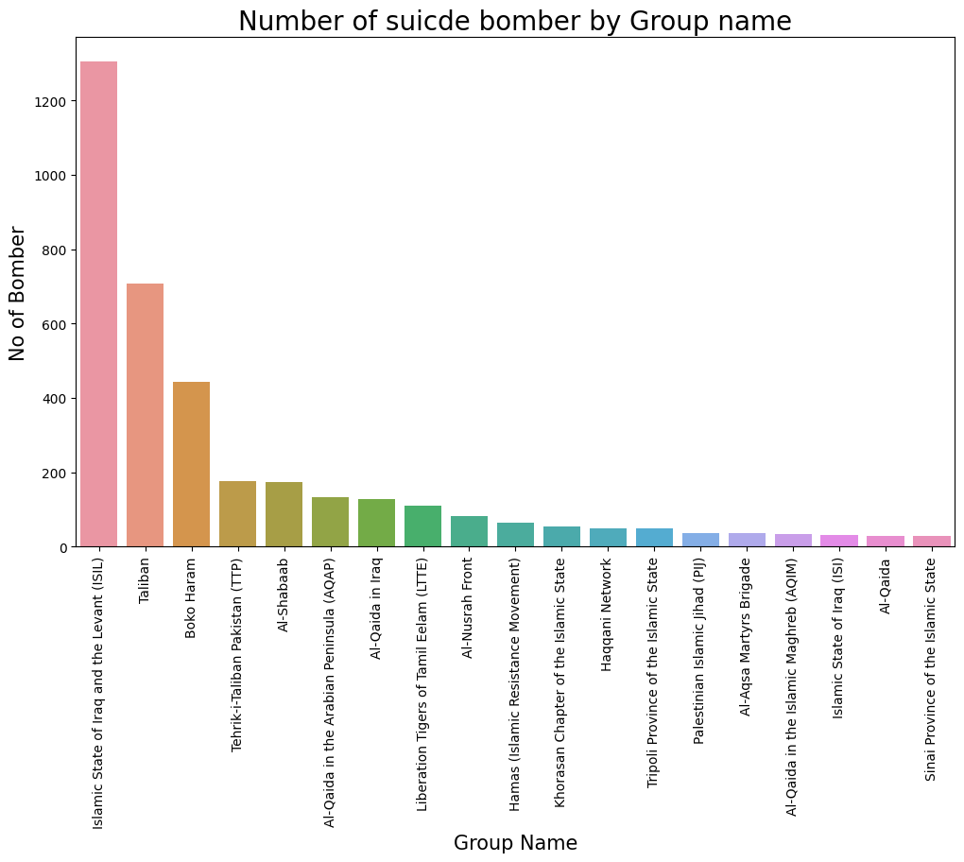
This bar graph represent Number of time groups used suicide bombing as a medium to take place their terrorist activity.
Here we can clearly see ISIL had most number of suicide bomber followed by Taliban.
Such stats are example that Terrorist are really strong on their motive and they doesn’t even care about their life.
Strong and proper actions should be taken by government of their country to stop such terrorist activity.

Slide 20
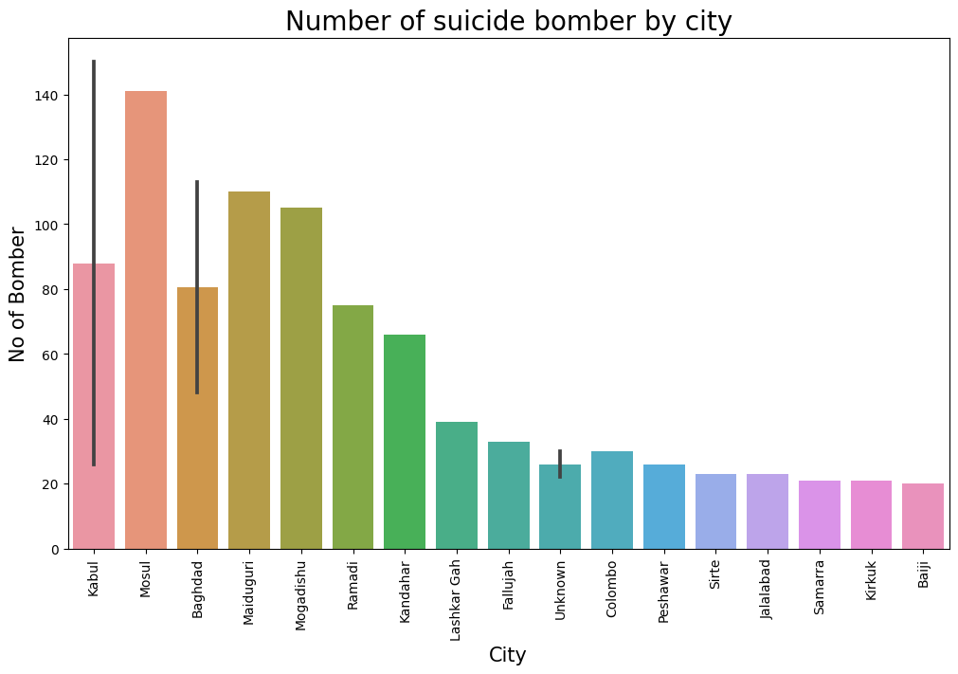
This chart shows that Kabul had most number of suicide attack which is more then 140, followed up by Mosul.
In previous chart as we seen Taliban has really large number of suicide bombing we can clearly see here Kabul were their target place.

Slide 21
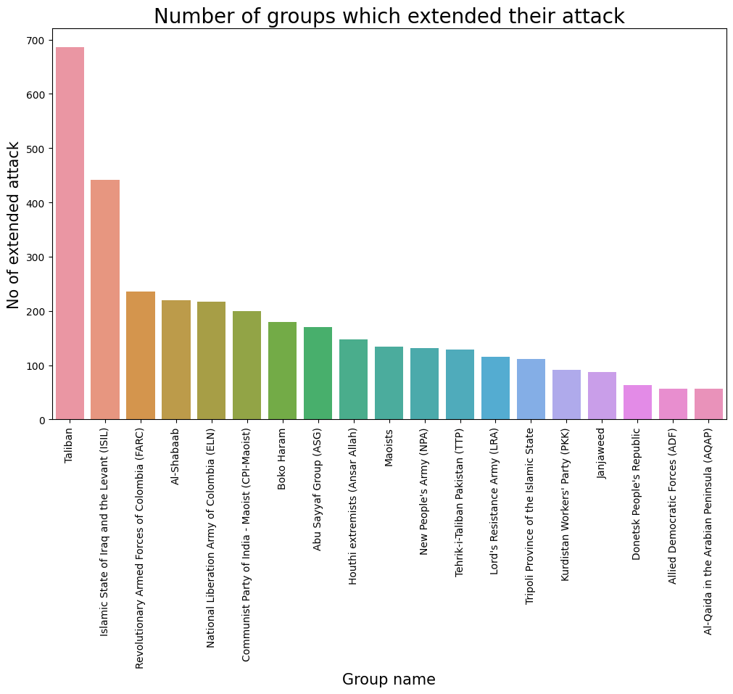
This bar graph shows us that how many time terrorist extended their attack for more then 24 hours.
Here Taliban has most number of extended attack which is close to 700, followed up by ISIL shich is around 450.
Here government should identify their trend and pattern of attack to prevent such more cases.

Slide 22
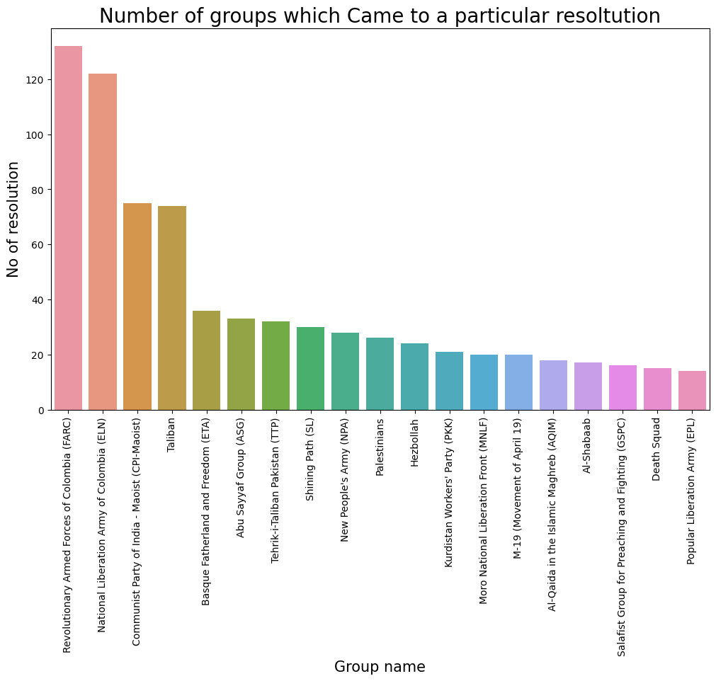
This bar graph shows Numbers of time terrorist group came under particular solution.
Such things shows us that these terrorist group can come under particular solution.
Here Revolutionary Armed Forces of Colombia(FARC) is the group which came under resolution for most of the time, Followed up by National Liberation Army of Colombia(ELN).

Slide 23
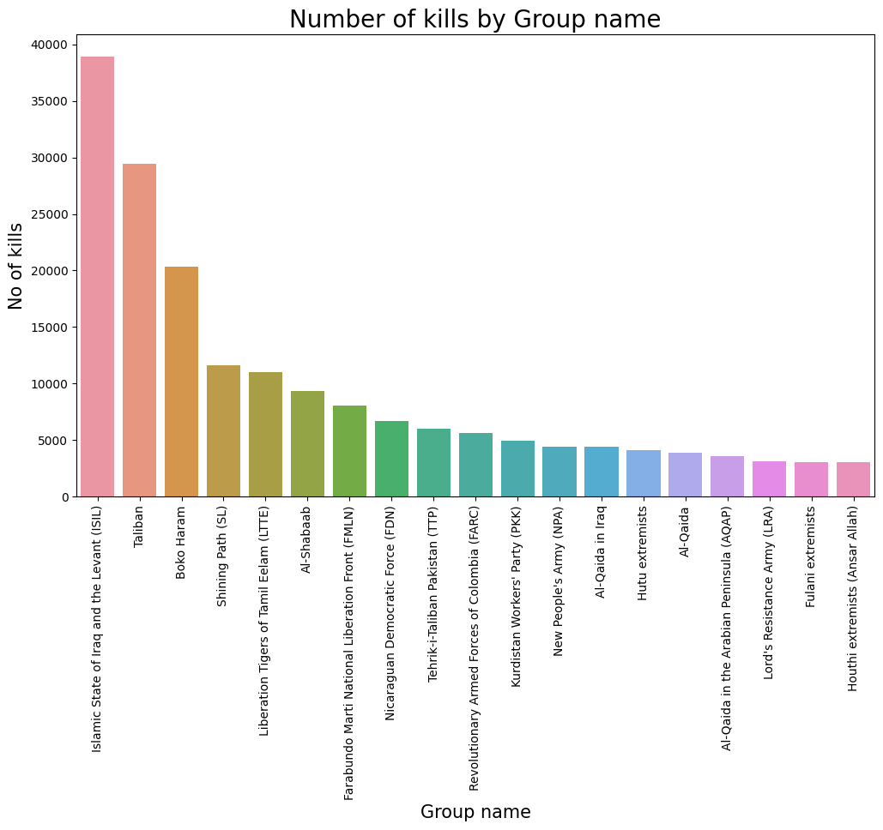
This bar graph clearly shows us how many people were killed by each respective group.
Here we can clearly see ISIL had most number of kills which is more then 35000 following up by Taliban which had around 30000 kill.
Has we know this data is till 2017, there must be increase in kill by these group.

Slide 24
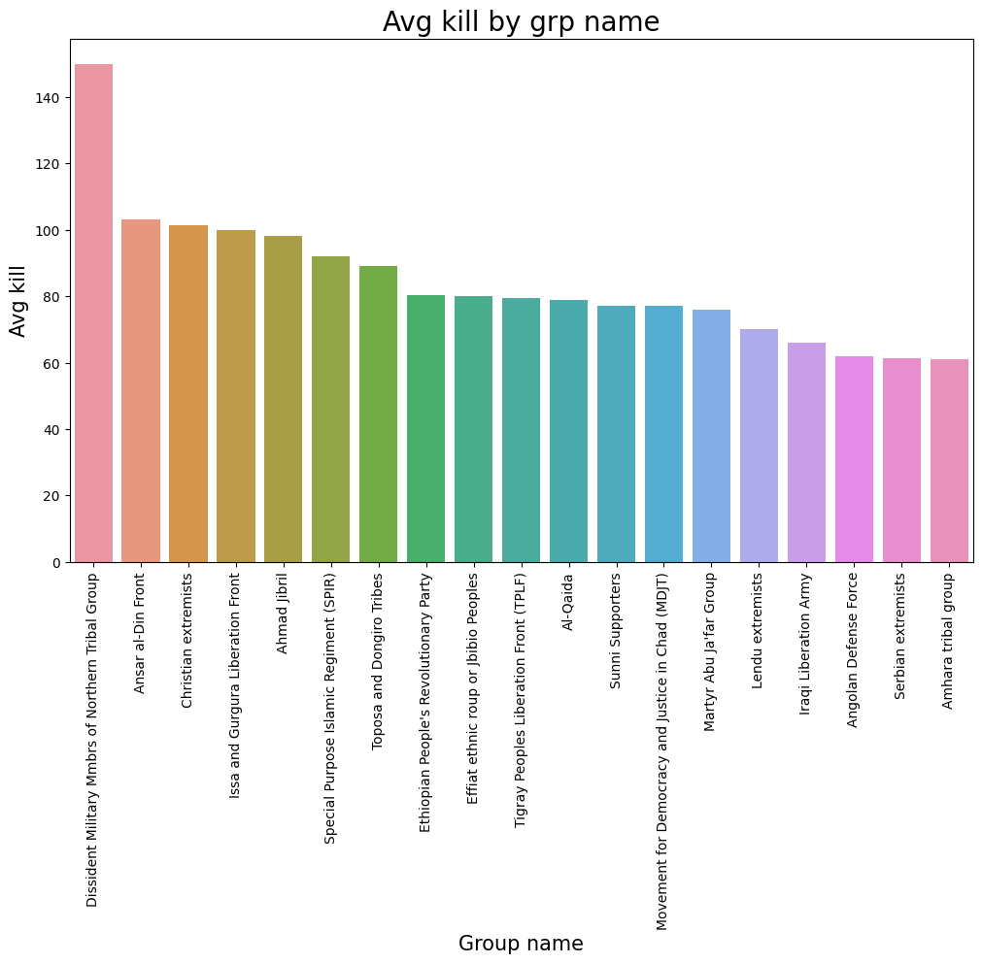
This bar graph shows us Avg kill by respective Terrorist group.
Here we can clearly see Dissident Military Mmbrs of northern Tribal Group had most number of Avg kill per attack which is around 145 kill per attack, following up by Ansar al-dim which had 100 kill per attack.
As we have seen in previous chart Taliban and ISIL had most number of kill but here we can see there Avg kill is quite low.
The reason behind there more number of kill is more number of attack by them compare to others.

Slide 25
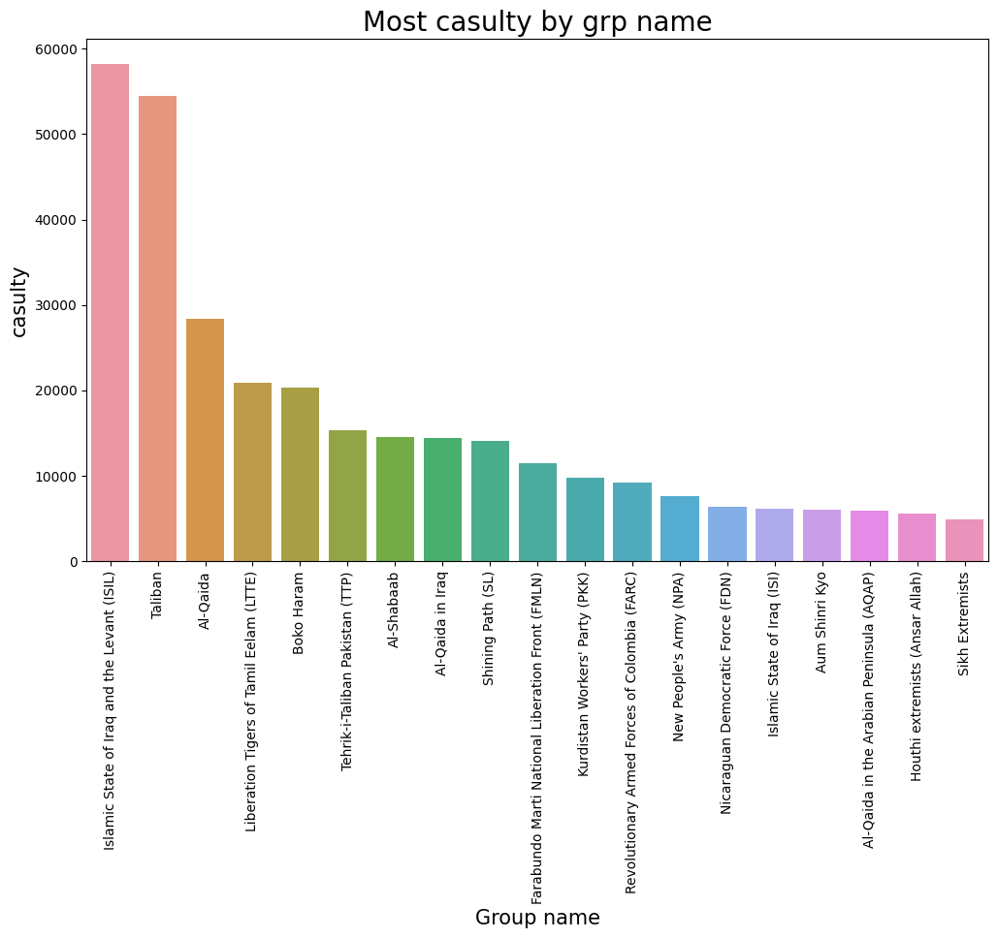
This bar graph tells us that ISIL had most number of casualty. Casualty is simply addition of kill and wound.
Taliban had 2nd most number of casualty which is around 54000.

Slide 26
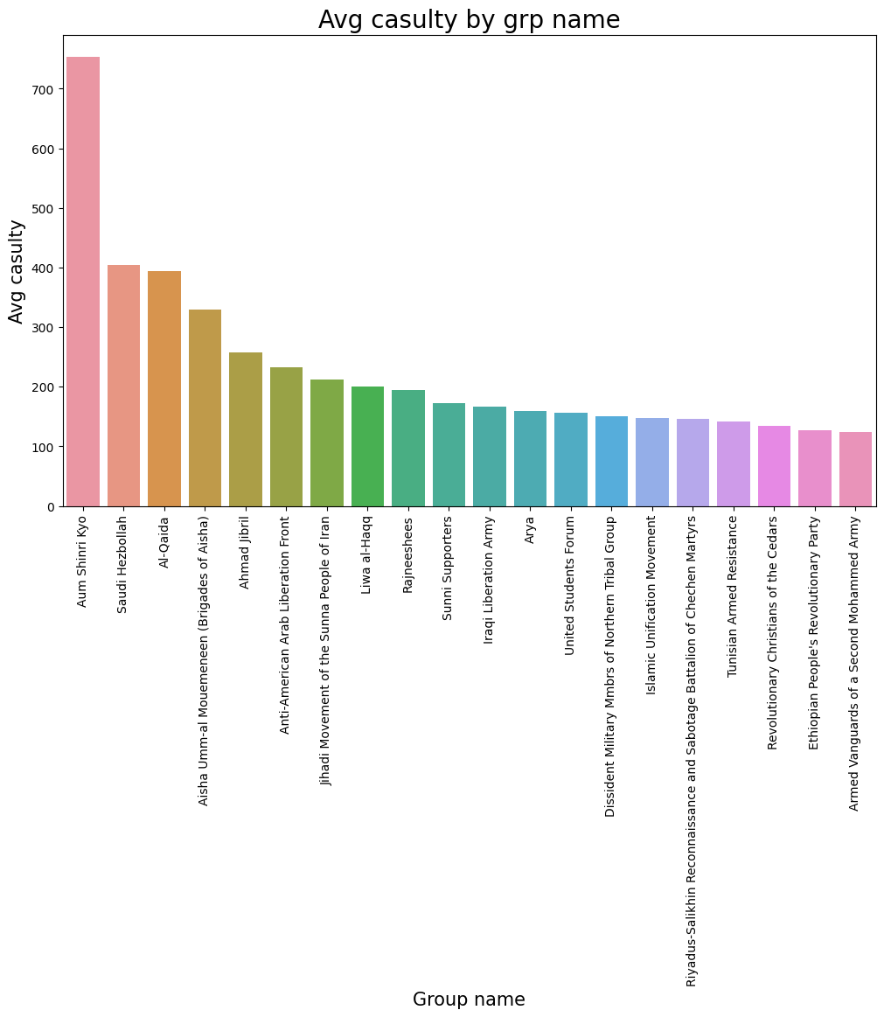
This bar graph tells us Avg casualty per attack by terrorist group.
Here we can clearly see AUM SHINRI KIYO had most Avg casualty per attack which is around 750 casualty per attack. Following up by SAUDI HEZBOLLAH which has around 400 casualty per attack.

Slide 27
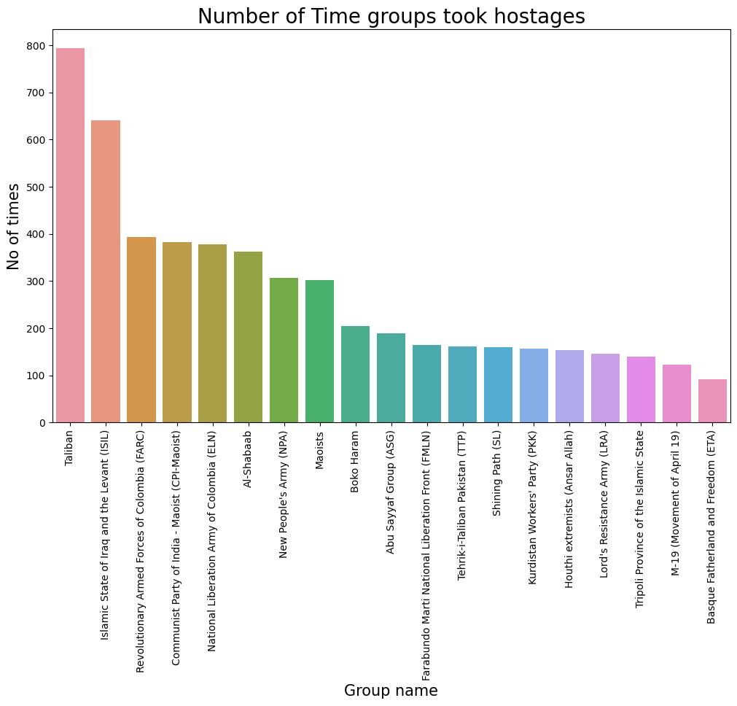
This bar graph shows us how many time particular group took hostage as a medium for attack.
Here Taliban had most no of hostage attack followed up by ISIL.

Slide 28
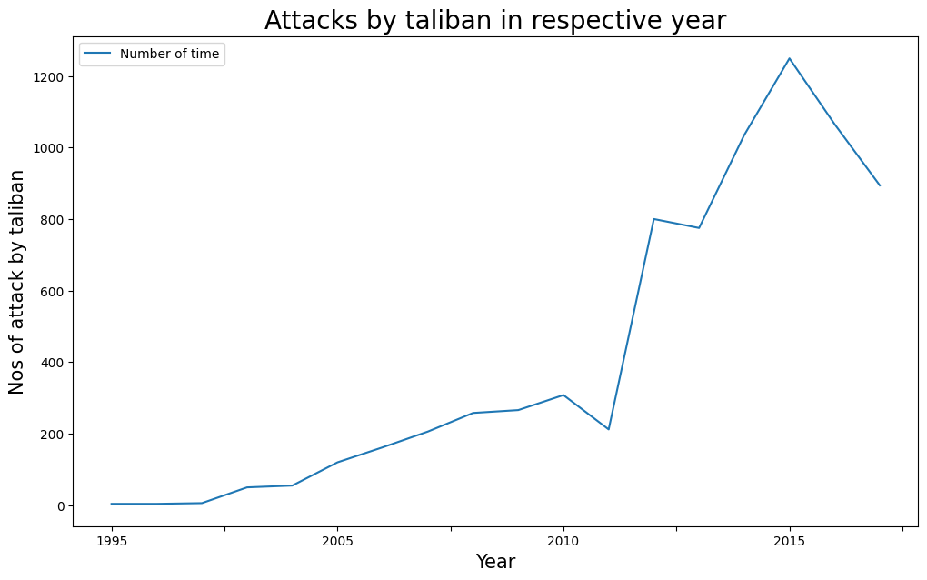
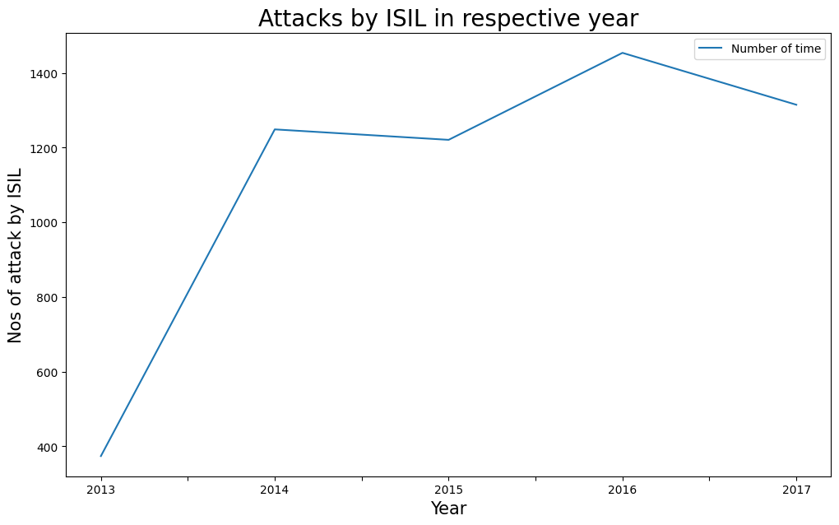
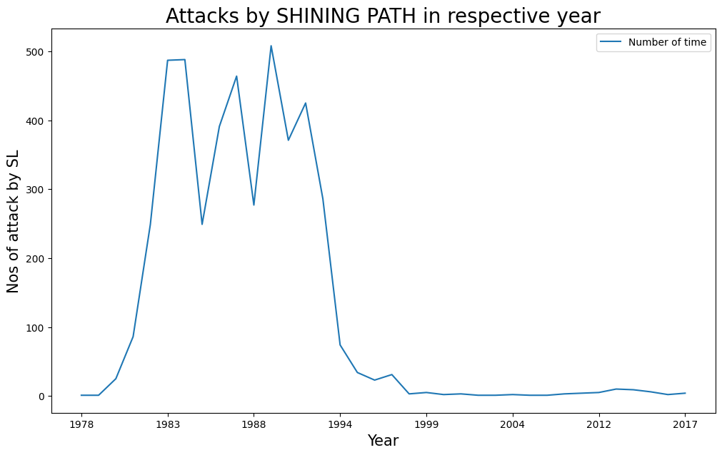
These line graph tells us how there is increase or decrease in attack by respective group in each year.

Slide 29
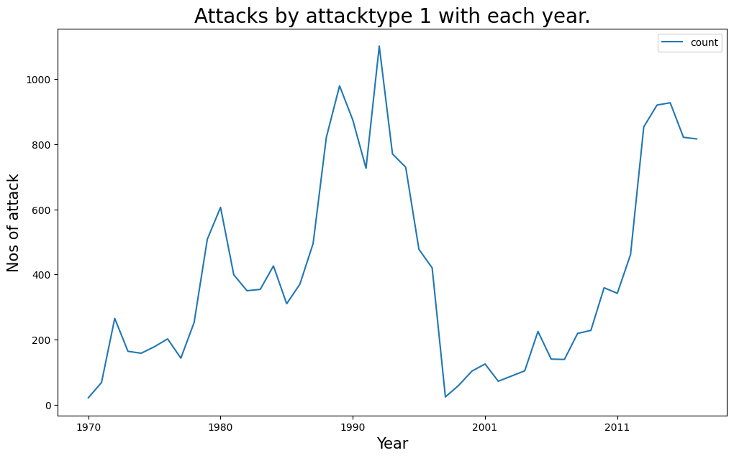
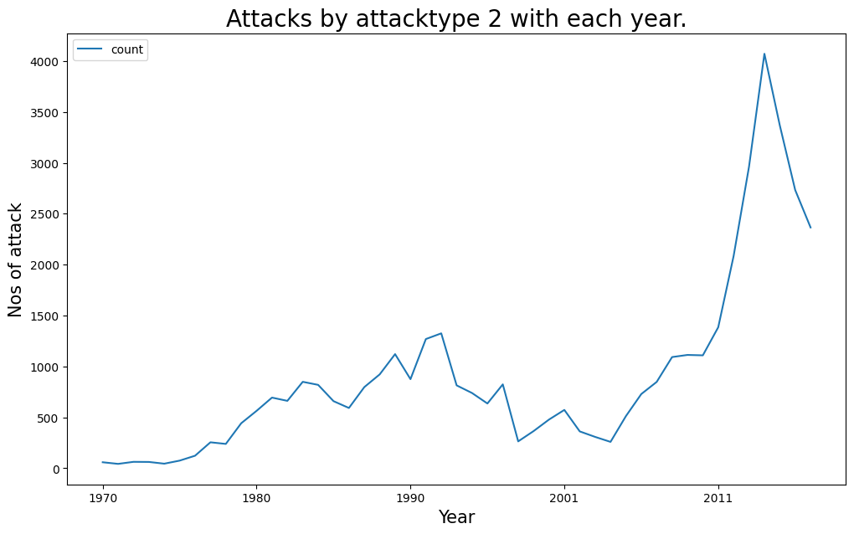
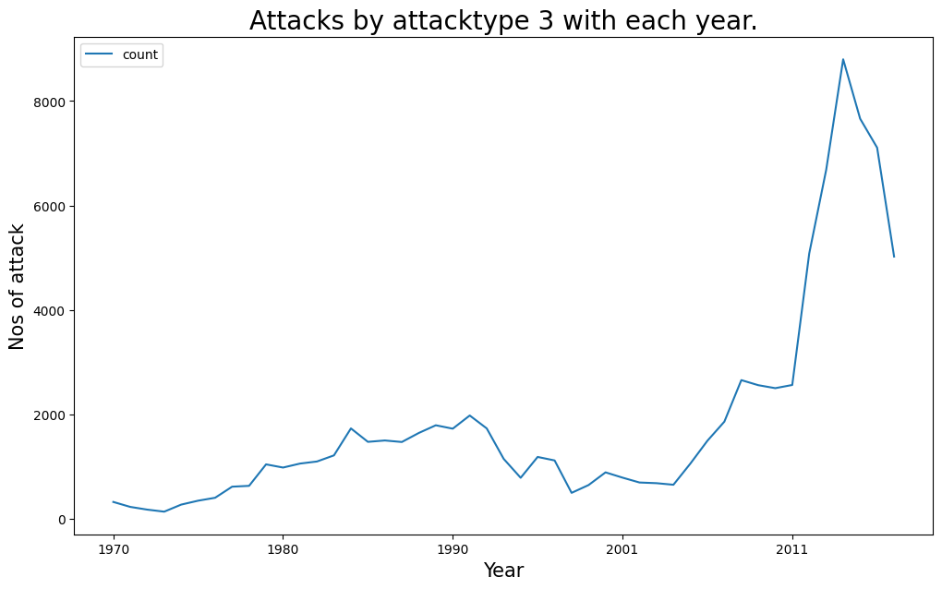
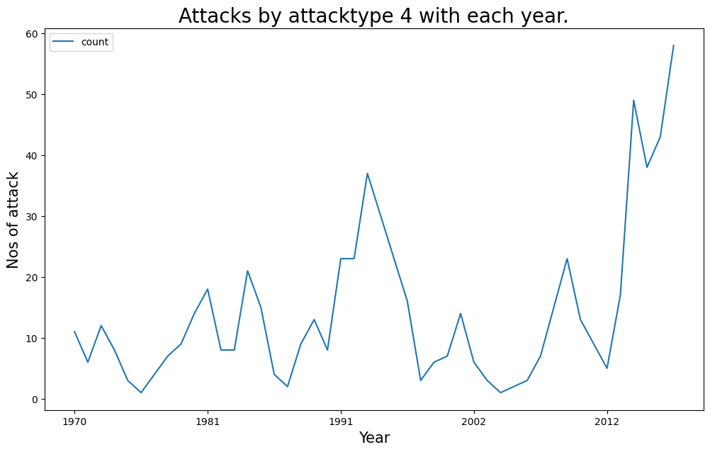
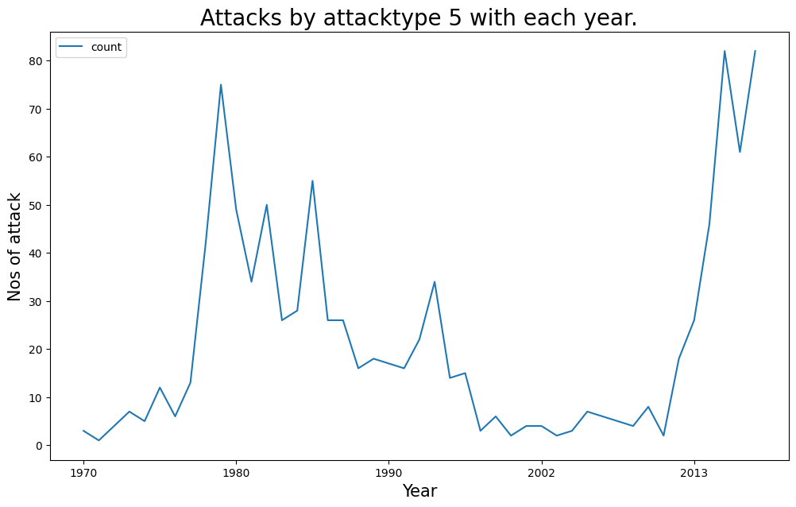
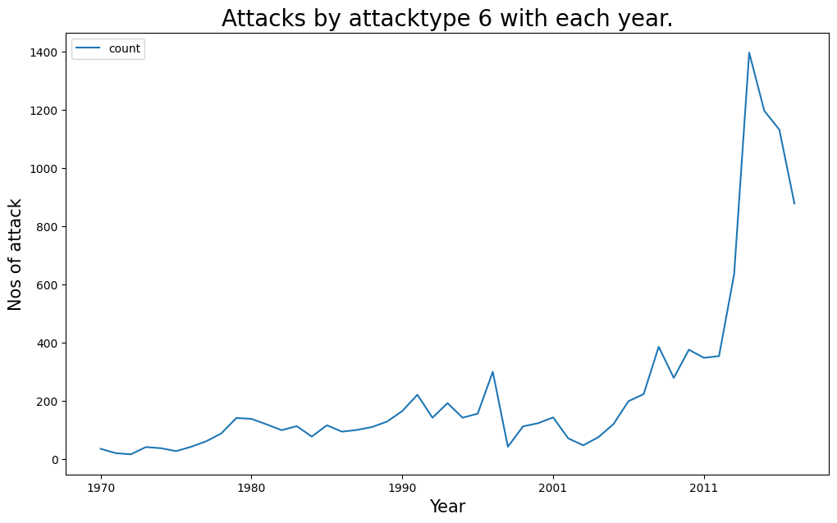
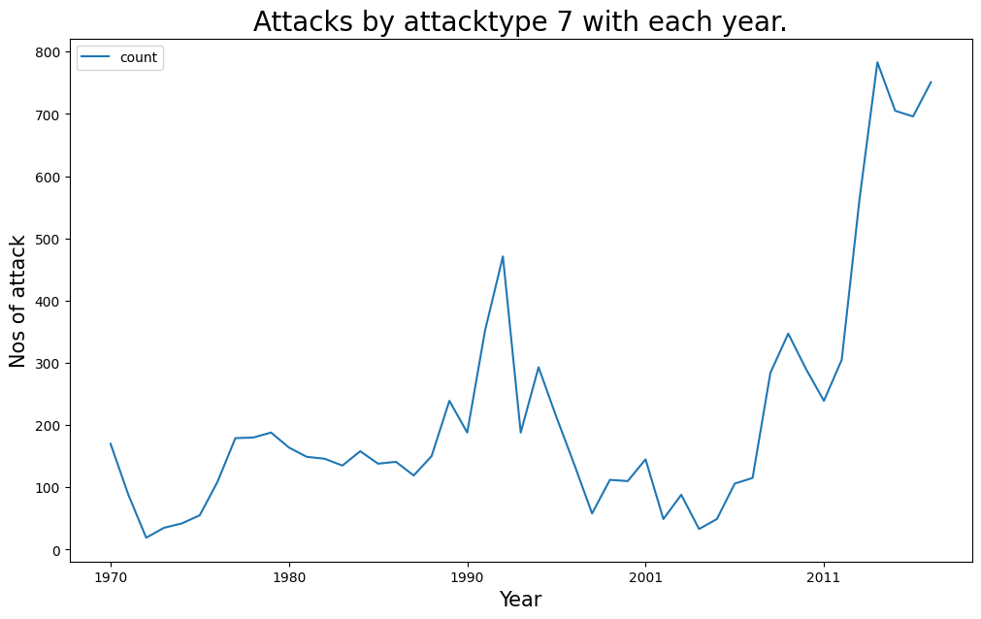
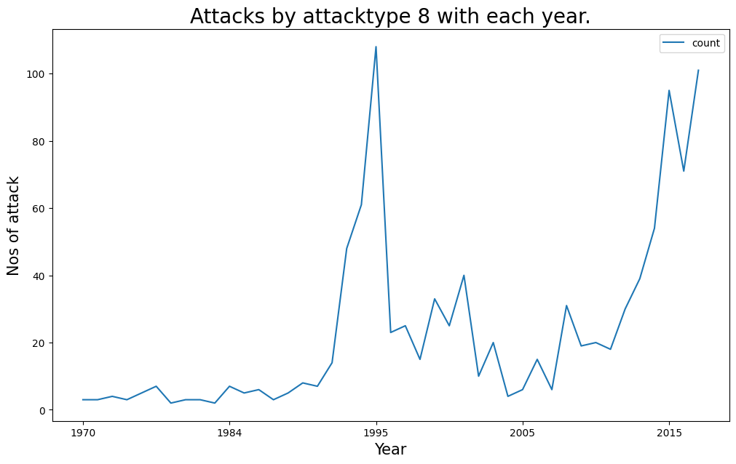
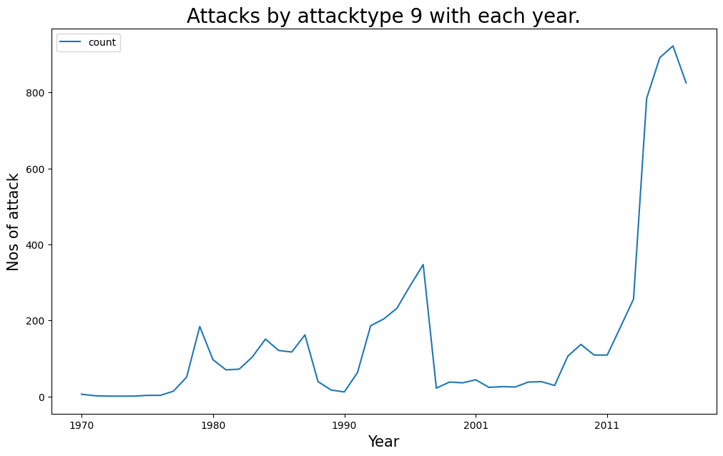
Assassination
Armed Assault
Bombing/Explosion
Hostage Taking (Barricade Incident)
Hostage Taking (Kidnapping)
Hijacking
Facility/Infrastructure Attack
Unarmed Assault
Unknown

Slide 30
Conclusion
Terrorism is a complex issue that requires a multifaceted solution involving a combination of social, political, and economic measures. Some potential solutions include:
---Strengthening law enforcement and intelligence gathering: This can involve increasing resources for law enforcement agencies and intelligence gathering efforts to identify and prevent terrorist attacks.
---Addressing root causes of terrorism: This includes addressing issues such as poverty, political instability, and social inequality, which can contribute to feelings of marginalization and extremism.
---Countering extremist propaganda: Governments and civil society organizations can work to counter extremist narratives and promote more positive messages through education and media campaigns.
---International cooperation: Combating terrorism requires global cooperation, including sharing of intelligence and best practices, and coordinated efforts to disrupt terrorist networks.

Slide 31
Conlusion Cont…….
---Enhancing security measures: This includes measures such as improved border security, enhanced security at public events and critical infrastructure, and increased use of surveillance technology.
In addition to these measures, addressing the root causes of terrorism is also important, such as political instability, poverty, and social inequality. This may involve promoting good governance, economic development, and social justice.
Technology can also play a role in counter-terrorism efforts, such as by using data analytics and artificial intelligence to identify patterns and potential threats, and using advanced surveillance technologies to detect and prevent terrorist activities.
Ultimately, effective counter-terrorism requires a comprehensive and coordinated approach that involves collaboration between law enforcement agencies, intelligence services, governments, and civil society organizations.

Slide 32


